Slide 1
Edash
eDash
eCommerce Analytics Dashboard.

Slide 2
Agenda
AGENDA
Why eCommerce companies needs Analytics.
Introduction to eDash company and platform.
Client case study: Solo Moto Parts Inc.
UI website design: Shadi Salama
Database design: Vince Sy
D3, Leaflet and JavaScript:
Shadi A
Samira A
Q&A

Slide 3

Why
WHY ECOMMERCE NEEDS ANALUYTICS:
SALES DATA:
Products sales on company website and other marketplaces in US and Worldwide.
We need to know how much profit we make after all fees.
56%
65%
We need one dashboard to view the sales on all marketplaces
MARKETING DATA:
Online advertising, Digital marketing and Social Media.
Of Amazon sales from SM Business
50%
We need one tool for Marketing, Sales and Finance repots.
80%
FINANCE DATA:
We need reports for international sales on Amazon UK, Japan and Middle East.
Profit and Lost numbers for each order on each sales channel or marketplace. Sales projection and budgeting.
73% of these sellers also they sell on other marketplaces like eBay, Walmart, etc.
35%
Notes:
In a recent study by eCommerce organizations, they found that 56% of amazon sales is coming from 3rd party of a Small and Medium companies.
73% of these companies are also selling on other marketplaces like eBay.com, Walmart.com, Newegg.com, etc. In addition to their website using Shopify, BigCommerce or any platform.
So, Why eCommerce companies need Analytics for the Data?
1) 65% of sellers said they need to know how much profit they make from each order after taking out all the fees, like marketplace fees, shipping fees, transaction fees, taxes and any other variable cost.
2) They need one dashboard to show the sales from all channels in one tool.
3) They need all sales, marketing and finance reporting in one tool.
4) They need all the international sales in one tool.
So, here we are dealing with 3 different data sources
Sales
Marketing
Finance

Slide 4
Platform intro
Marketplace Online Sales Analytics
eDash Platform.
eDash is an eCommerce Analytics Platform that will give you a dashboard and reports for Sales, Marketing and Finance.
Website and Marketplace Online Sales Analytics
eDash
Profit & Lost Analytics
Marketing and Advertising Analytics
Marketing and Advertising Analytics .
Profit & Lost Analytics

Slide 5

How it works 1
How it works
It’s a self-service solution for eCommerce companies that can be managed by the analytics team and they can give access to other departments like Sales, Marketing and Finance.
Step 1: Select your package:
Sing up and create account.
Step 2: Integration:
Select marketplace form the setting and login with the credentials Like Amazon, eBay, etc.
Select the Advertising tools like Google AdWords, Facebook Ads, Email marketing, etc.
Step 3: Connect products source:
Connect the product source to pull the product details like Selling price, Item Cost, Shipping cost.
Step 4: Enjoy the Dashboard

Slide 6
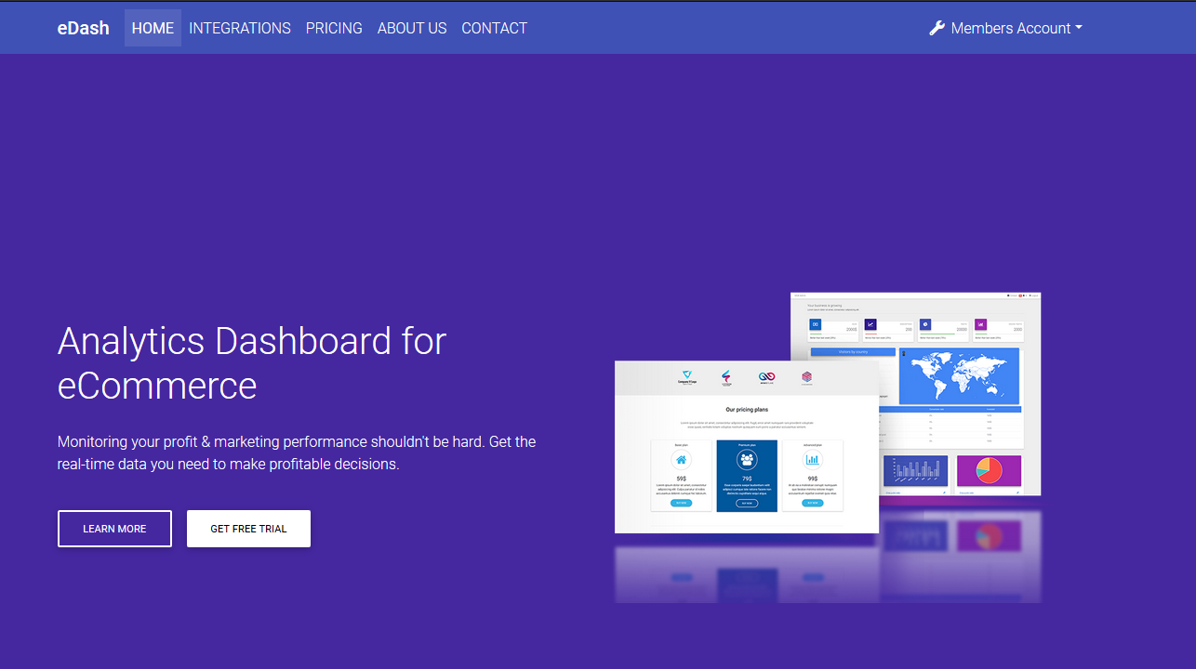
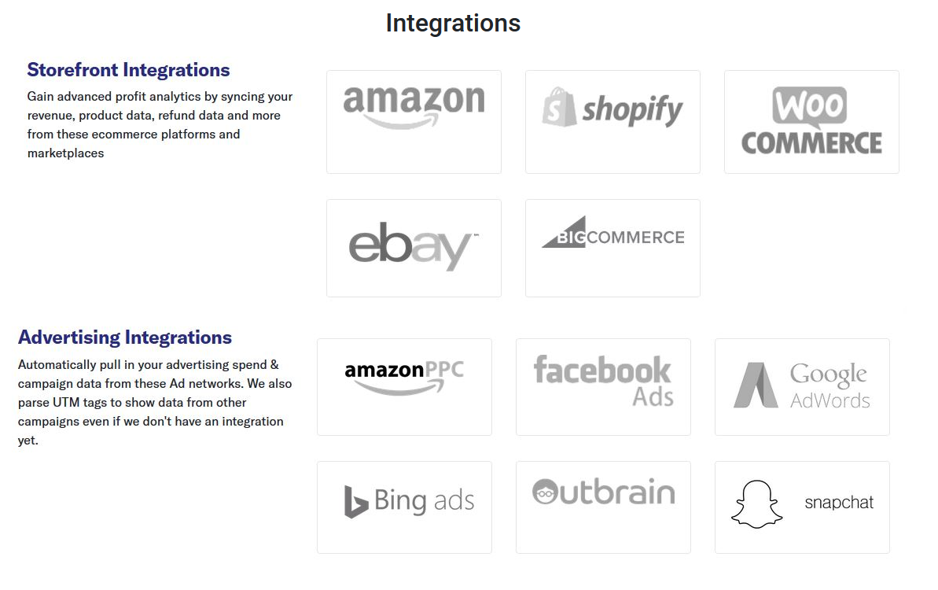
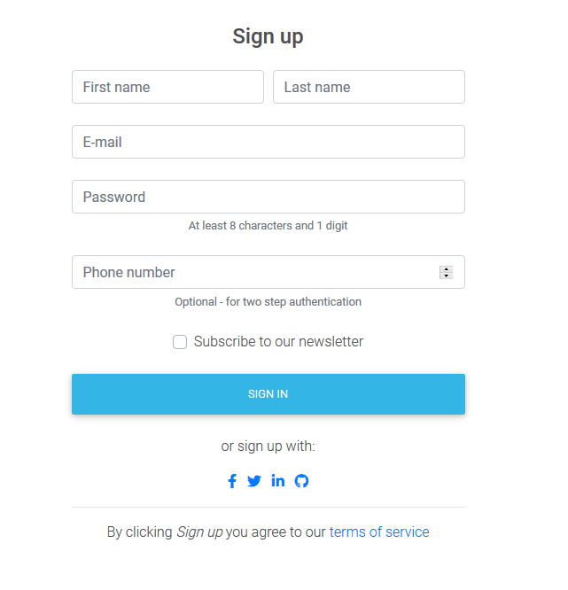
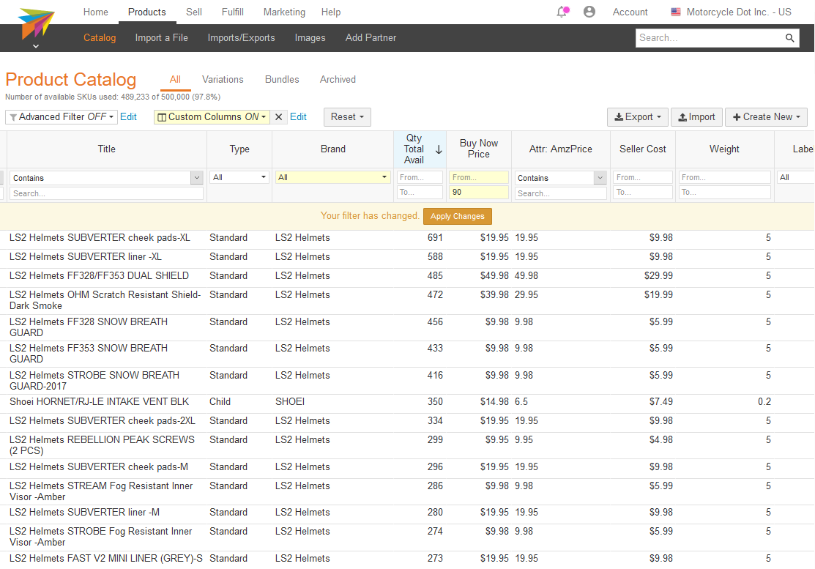
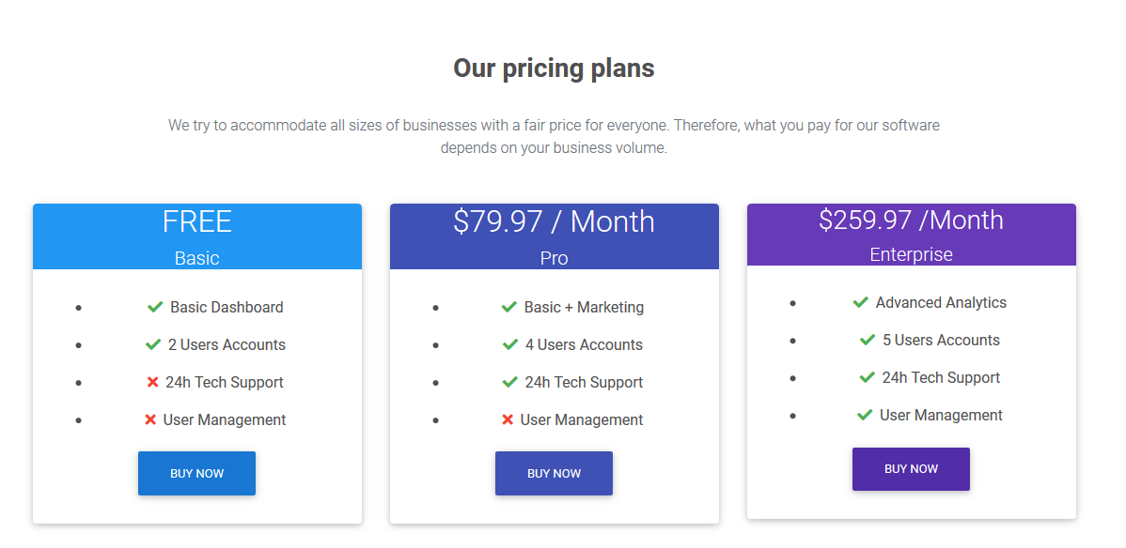
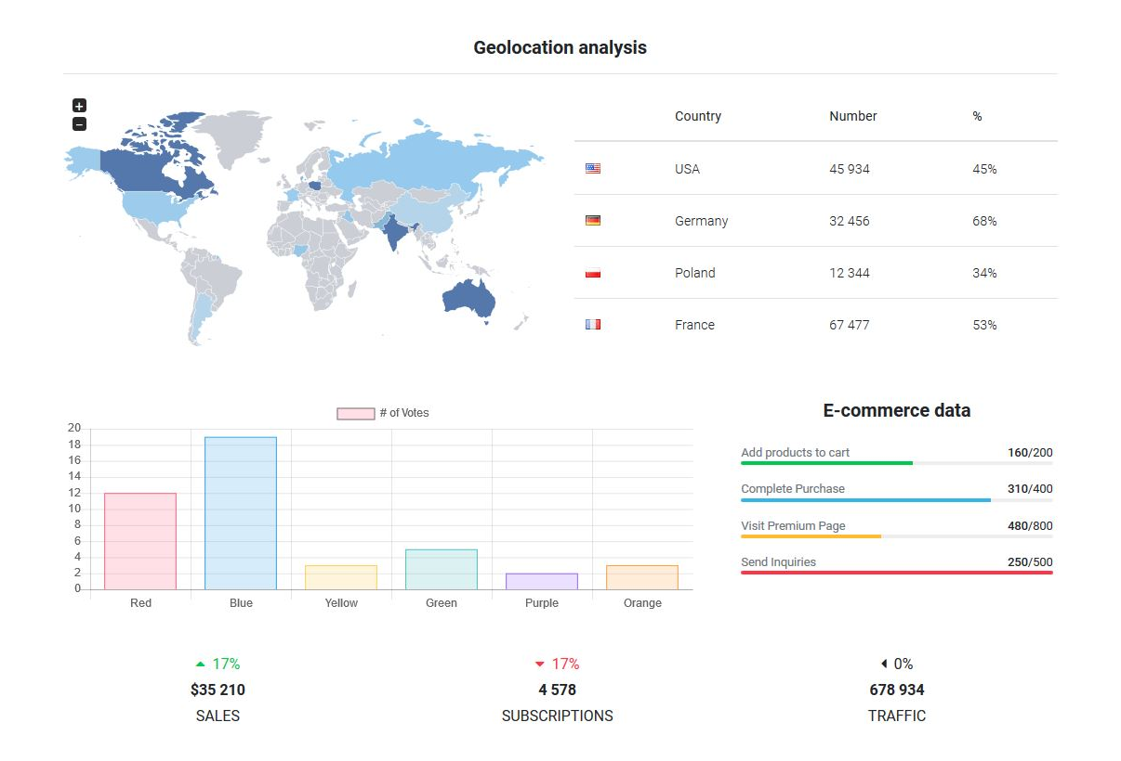
How it works 2
How it works

Slide 7

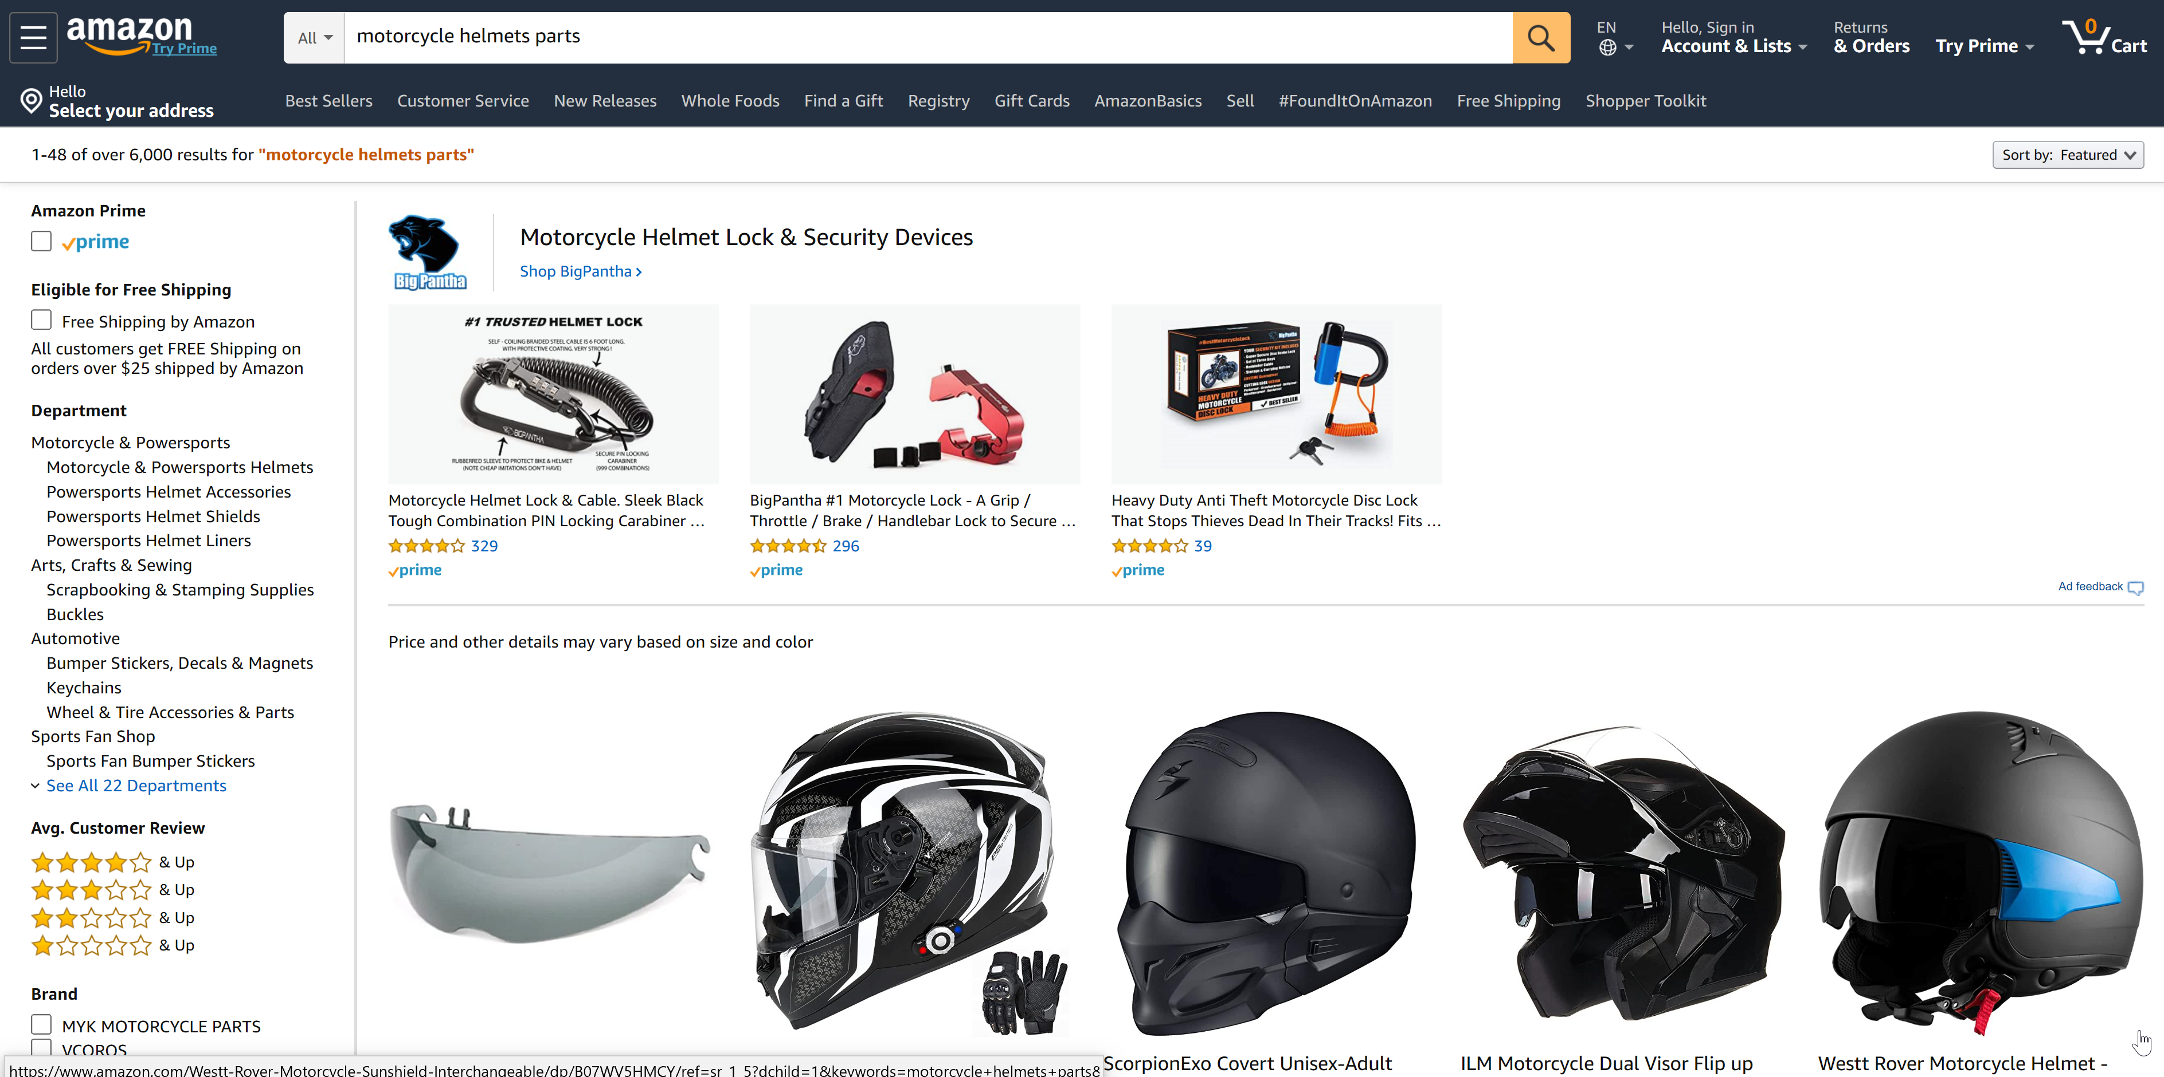
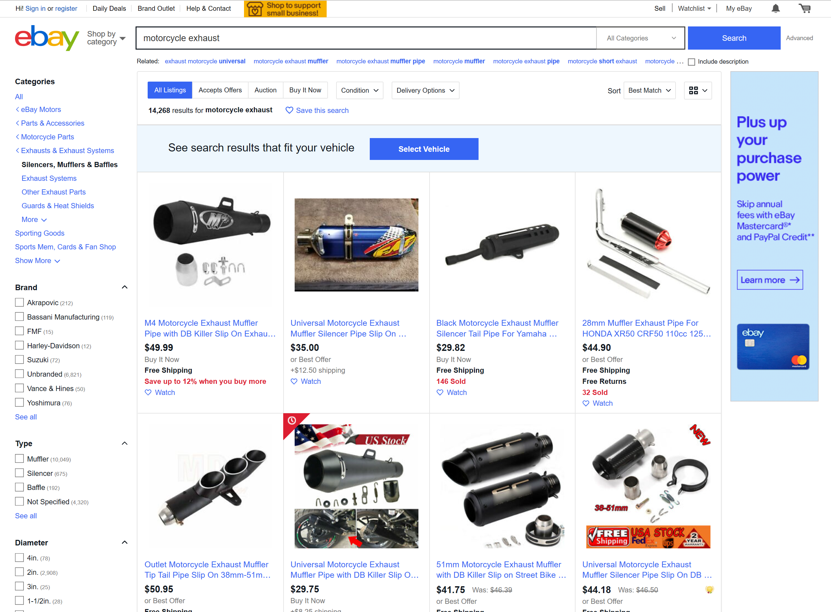
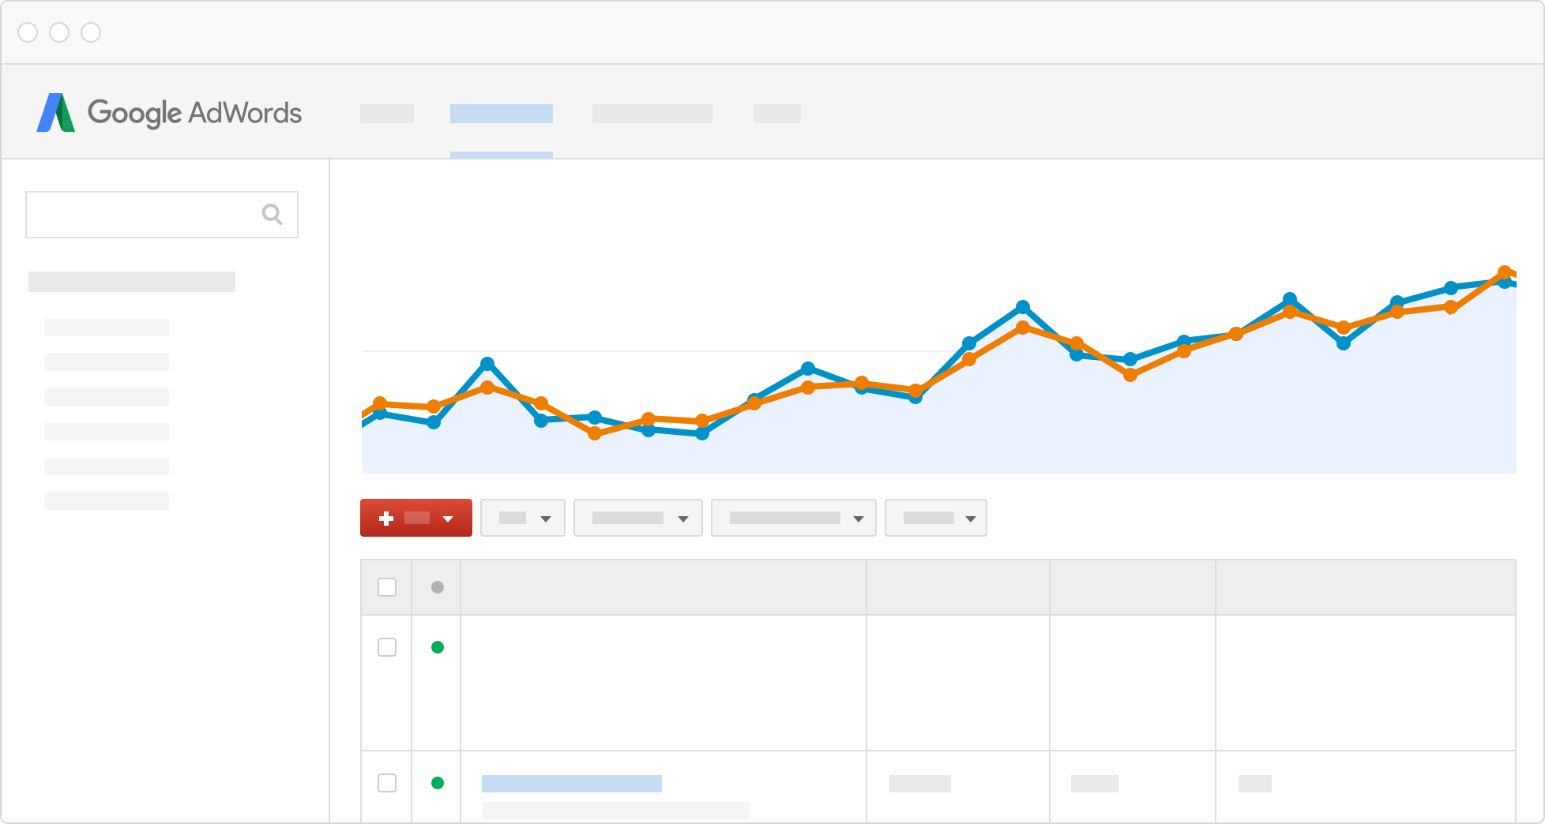
Client
Client Case Study

Slide 8
How 1
Coding:
Using JavaScript, D3. We created Sales Trend Chart, Brand Trend Chart and Marketplace Chart.
Database:
User Interface:
Database analysis, ETL and Modeling. Using Python, Pandas, PostgreSQL and Alteryx.
Website design, User Interface using HTML, CSS, Adobe Dreamweaver, Bootstrap components and blocks.
Business Analysis:
Hosting:
The website is hosted in GitHub
Business and data understanding.
How did we work on the project?

Slide 9
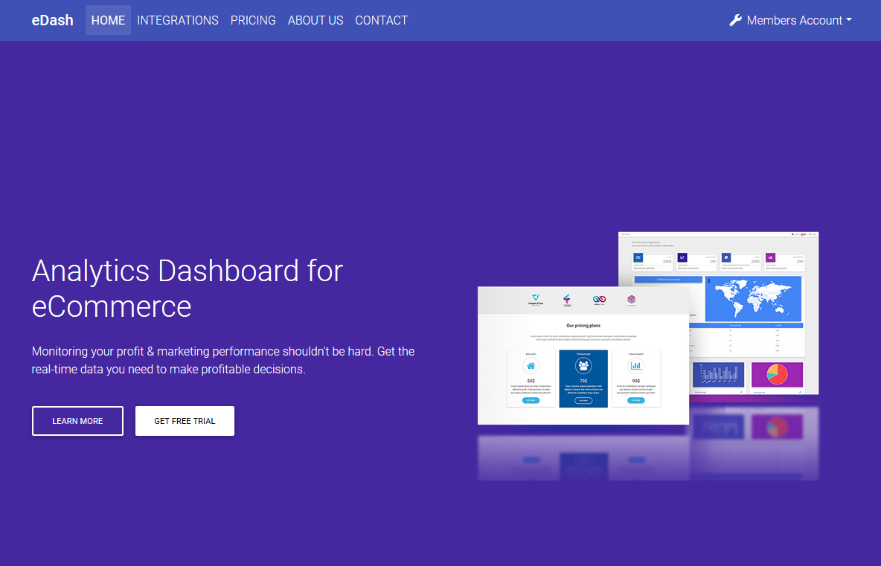
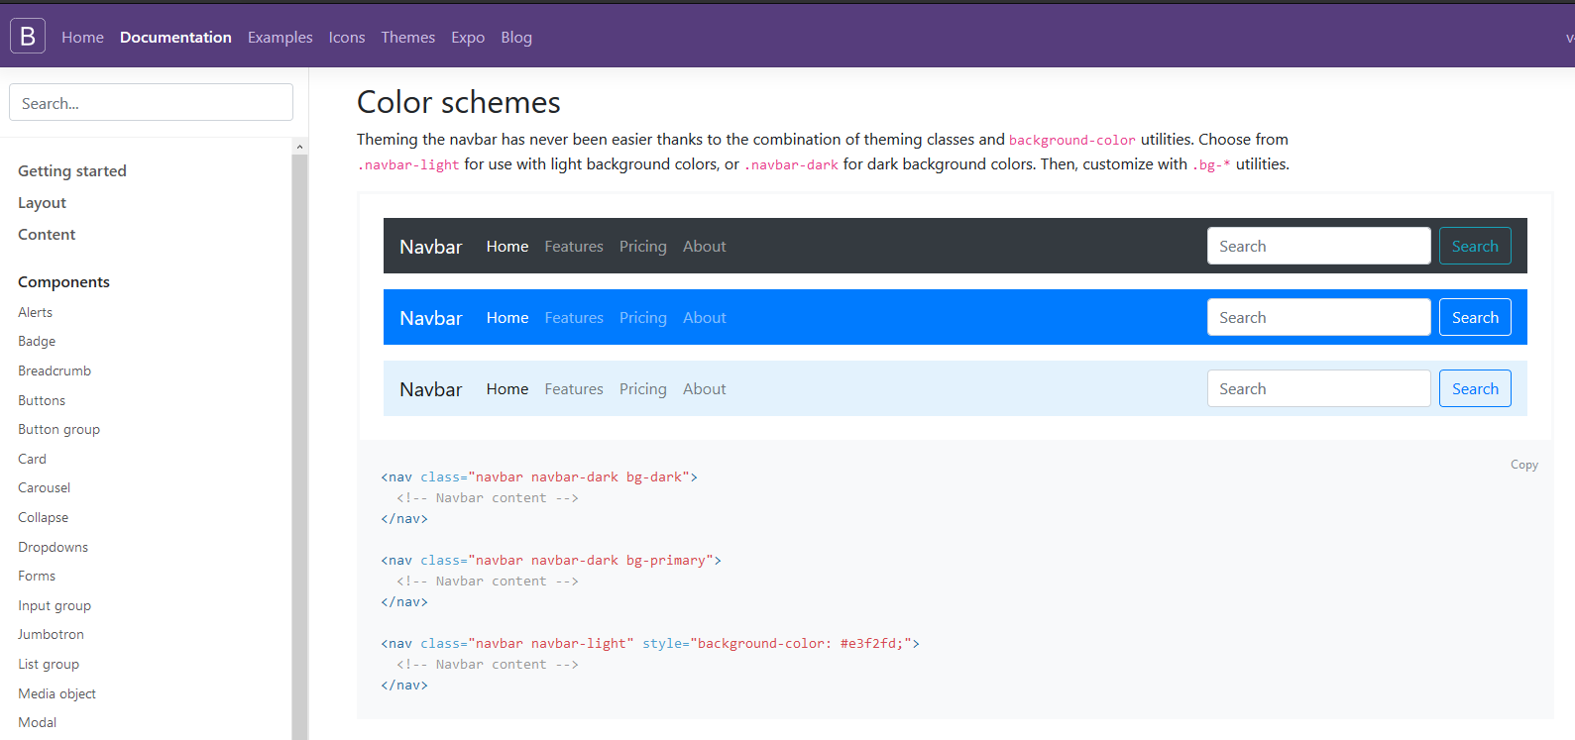
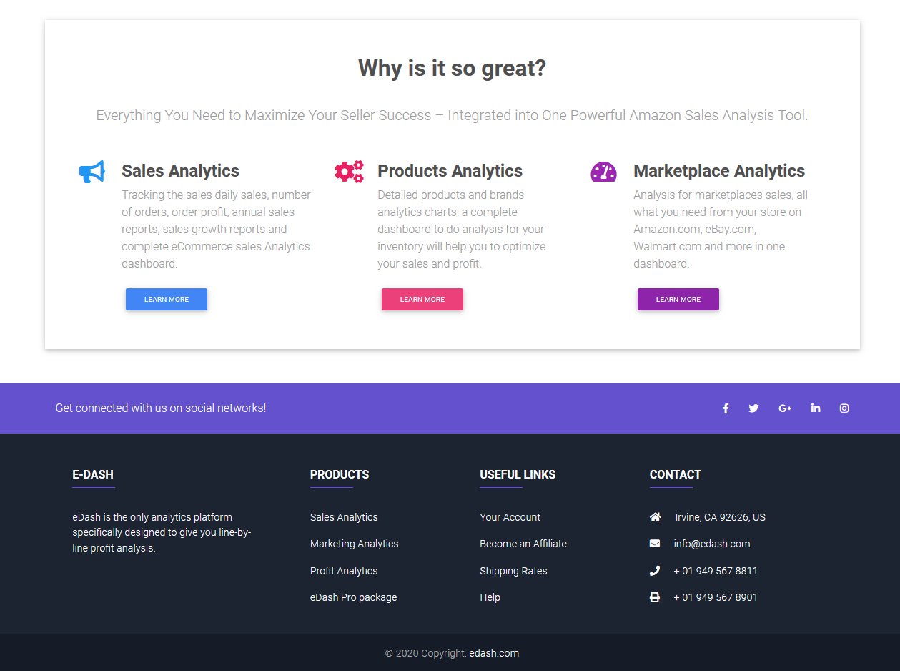
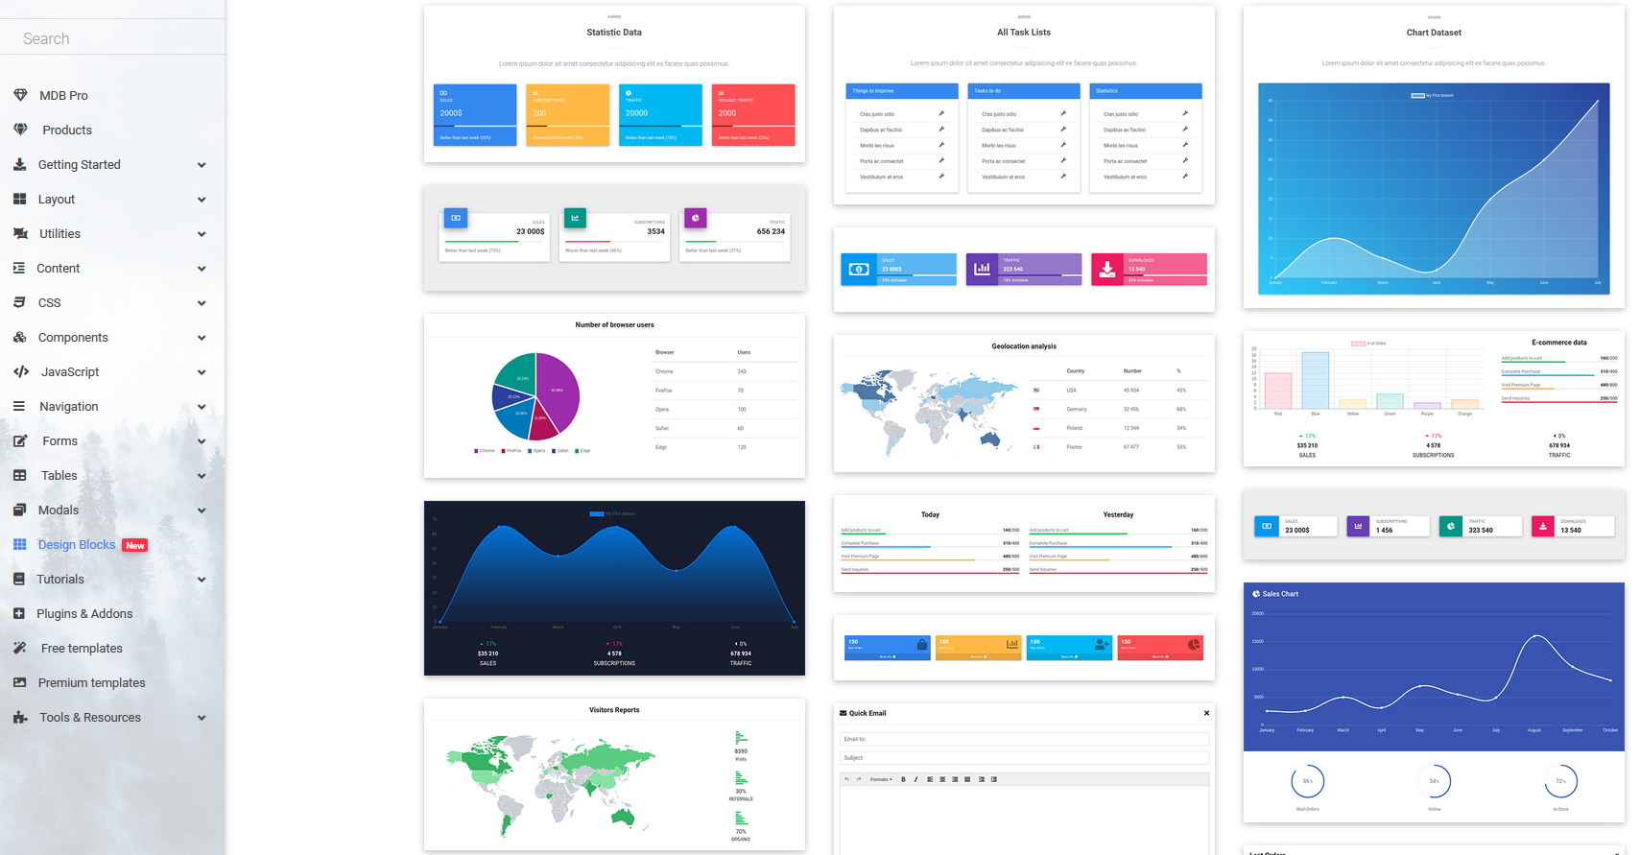
How Shadi S
Business Analysis:
User Interface:
Hosting:
Business and data understanding.
Website design, User Interface using HTML, CSS, Adobe Dreamweaver, Bootstrap components and blocks.
The website is hosted in GitHub
Shadi S.

Slide 10
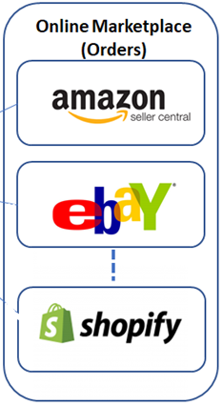

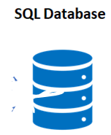
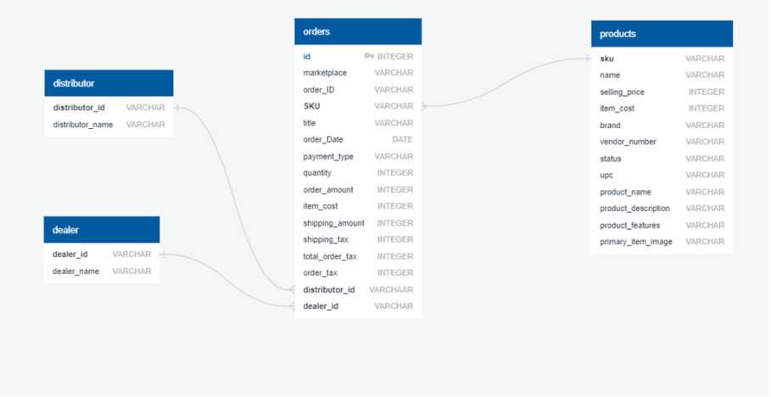
How Vince.
Database:
Database analysis, ETL and Modeling. Using Python, Pandas, PostgreSQL and Alteryx.
Vince Sy.

Slide 11
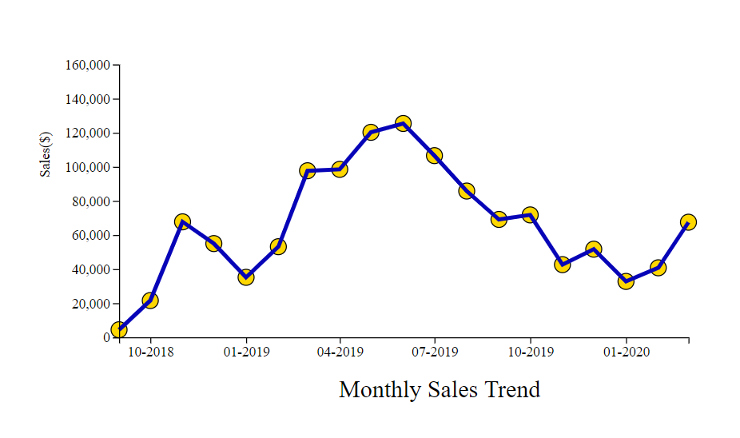
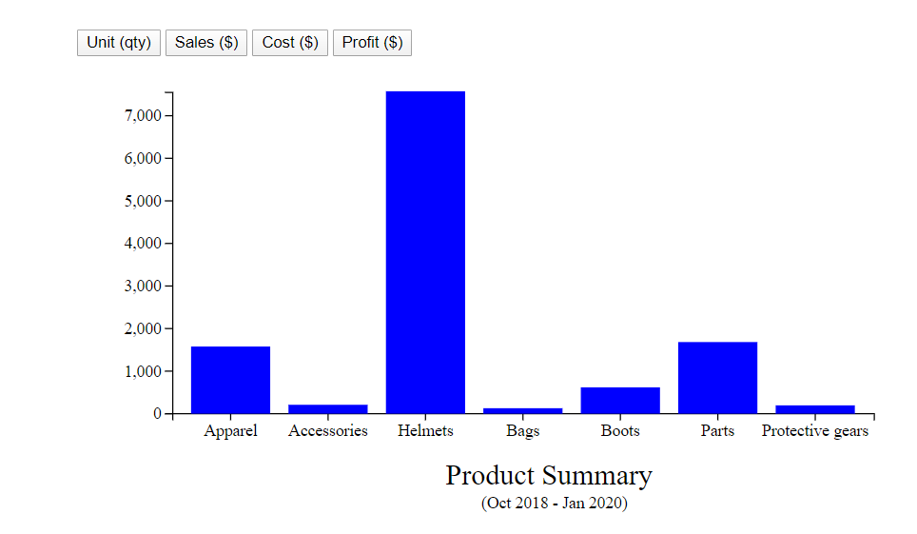
How Shadi A.
Business Analysis:
Coding:
Business and data understanding.
Using JavaScript, D3, LeafLet. We created Sales Trend Chart, Brand Trend Chart and Marketplace Chart.
Shadi A.

Slide 12
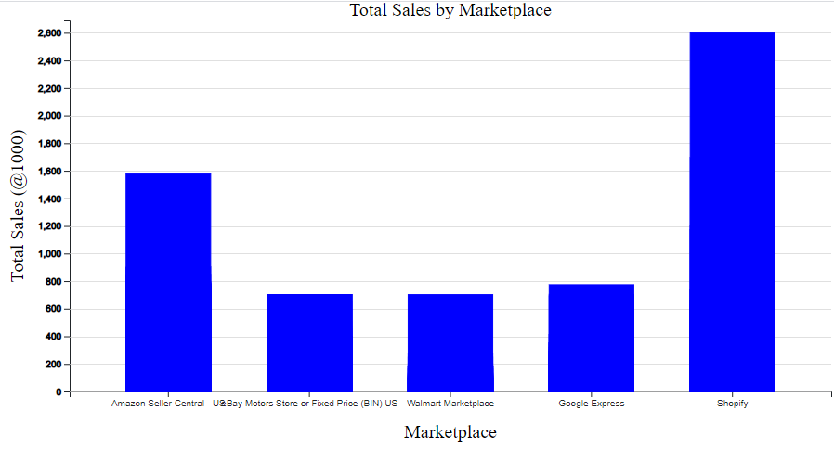
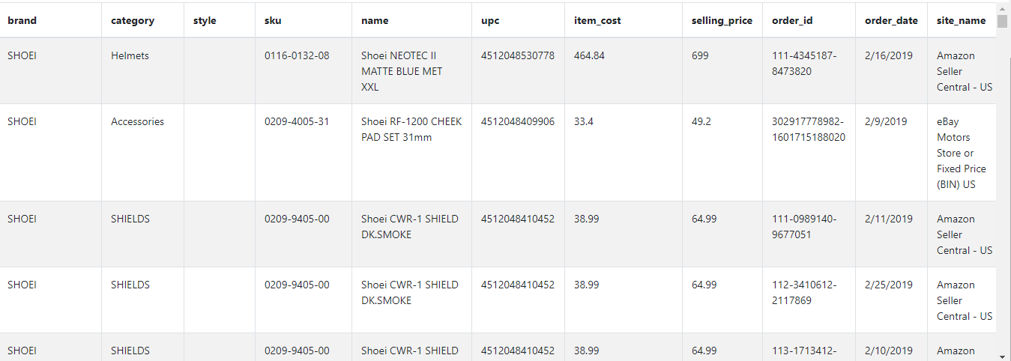
How Samira A
Business Analysis:
Coding:
Business and data understanding.
Using JavaScript, D3.Js
We created Sales Trend Chart, Brand Trend Chart and Marketplace Chart.
Samira A.

Slide 13
Thanks you
Q&A
Thank You
4/9/2020

